Slide 1
Nutrition Agent
CAPSTONE PROJECT
Presented By: NIKETHA ABIGAIL
Student name : NIKETHA ABIGAIL THANGARAJ
College Name & Department : Saranathan College of Engineering & B .Tech Artificial Intelligence & Data Science

Slide 2
OUTLINE
Problem Statement
Technology used
Wow factor
End users
Result
Conclusion
Git-hub Link
Future scope
IBM Certifications

Slide 3
Problem Statement
In today's health-conscious world, individuals face growing challenges in managing personalized nutrition due to evolving health conditions, busy lifestyles, cultural food preferences, and dietary restrictions. Existing tools offer static, one-size-fits-all diet plans that lack adaptability and real-time personalization.
Proposed Solution: An intelligent AI Nutrition Agent that leverages Natural Language Processing (NLP), multimodal inputs (text, image, voice), and LLM-powered reasoning to generate tailored meal plans, suggest smart food swaps, explain nutritional choices, and dynamically adapt to user feedback and goals. This virtual assistant bridges the gap between generic apps and in-person consultations—bringing expert-level guidance to everyone.

Slide 4
Technology used
IBM cloud lite services
Natural Language Processing (NLP)
Retrieval Augmented Generation (RAG)
IBM Granite model

Slide 5
IBM cloud services used
IBM Cloud Watsonx AI Studio
IBM Cloud Watsonx AI runtime
IBM Cloud Agent Lab
IBM Granite foundation model

Slide 6
Wow factors
This AI Nutrition Agent will revolutionize personalized diet planning, reduce dependency on static applications, empower users with real-time adaptive meal suggestions, and bridge the gap between clinical dieticians and everyday decision-making. It delivers expert-level guidance anytime, anywhere — tailored to individual health, habits, and culture.
Unique Features:
AI-generated, adaptive meal plans based on user input and evolving health data
Smart food substitutions for dietary restrictions, allergies, and goals
Contextual explanations for every recommendation ("Why is this food better?")
Multimodal support: accepts voice, text, and image inputs (e.g., grocery labels)
Learns from continuous user feedback to refine future plans
Culturally aware: supports regional and traditional diets
Optional integration with fitness trackers or wearable health devices

Slide 7
End users
Health-conscious individuals
Diabetics, weight watchers, or allergy sufferers
Fitness trainers and dieticians
Schools, colleges, or corporate wellness programs
Elders needing balanced meals

Slide 8
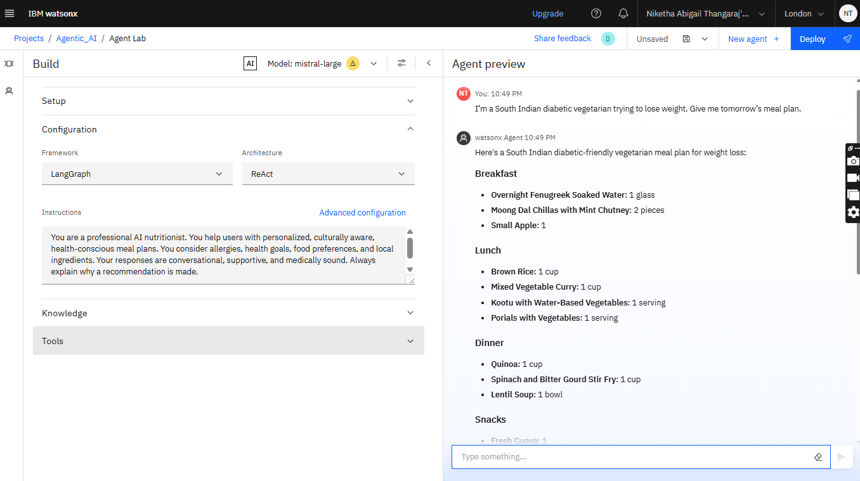
Results

Slide 9
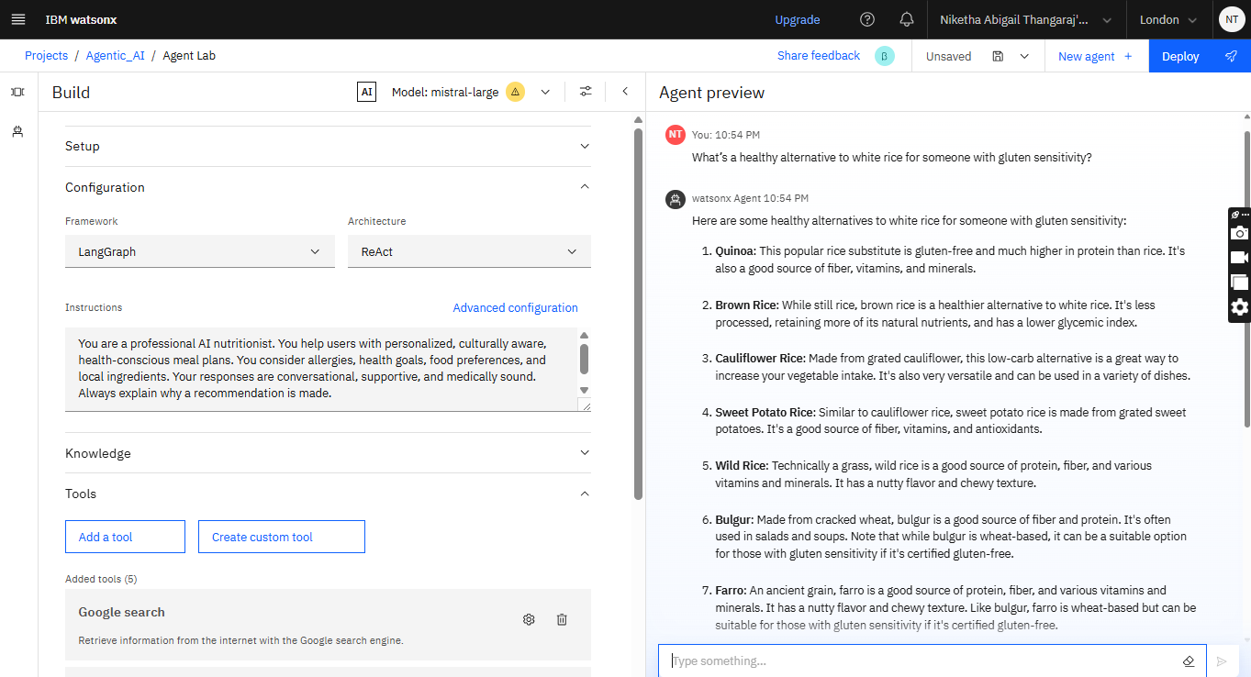
Results

Slide 10
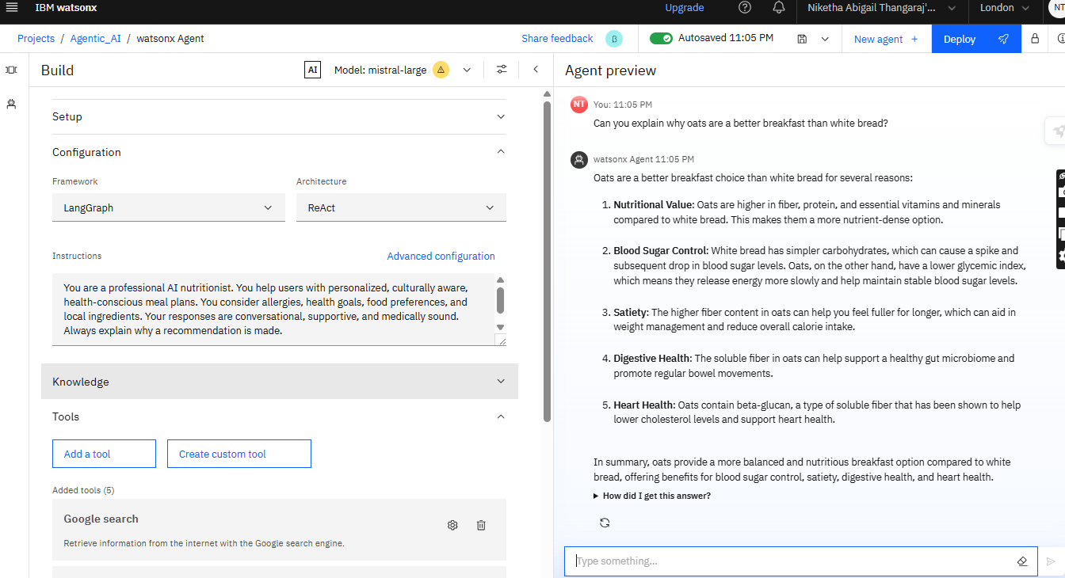
Results

Slide 11
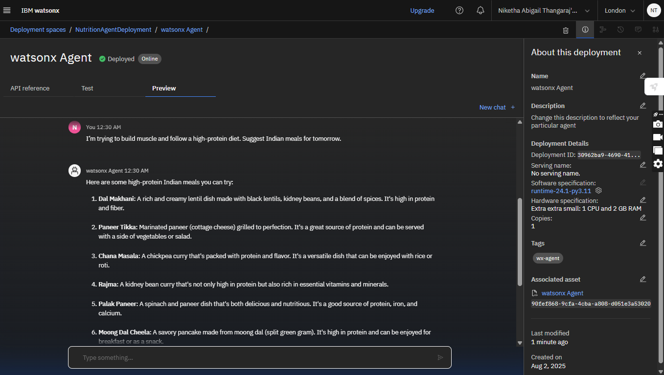
Results
Deployed AI Agent

Slide 12
Conclusion
The AI Nutrition Agent bridges the gap between one-size-fits-all apps and personalized consultations. It thinks, adapts, and explains like a real dietician—at scale.
It reduces time, improves health decisions, and increases accessibility to expert-level guidance.

Slide 13
Future scope
Integration with health wearables
Multilingual recipe recommendations
Voice assistant with calorie tracker
Real-time grocery list generation
Integration with fitness apps
Recipe photo upload for nutritional breakdown

Slide 14
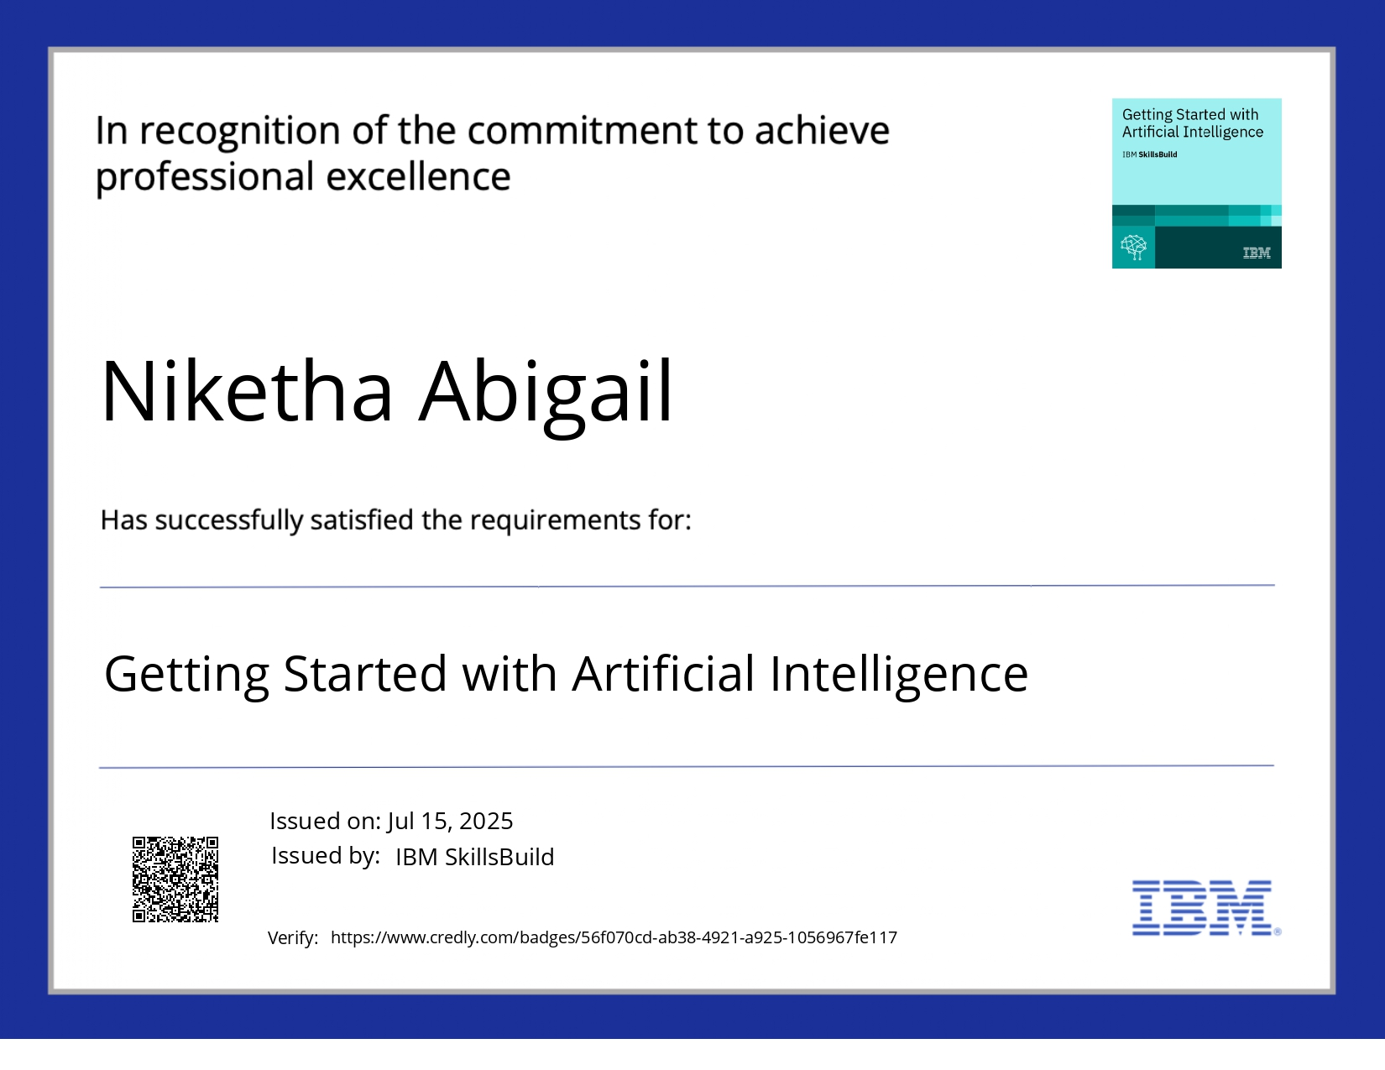
IBM Certifications

Slide 15
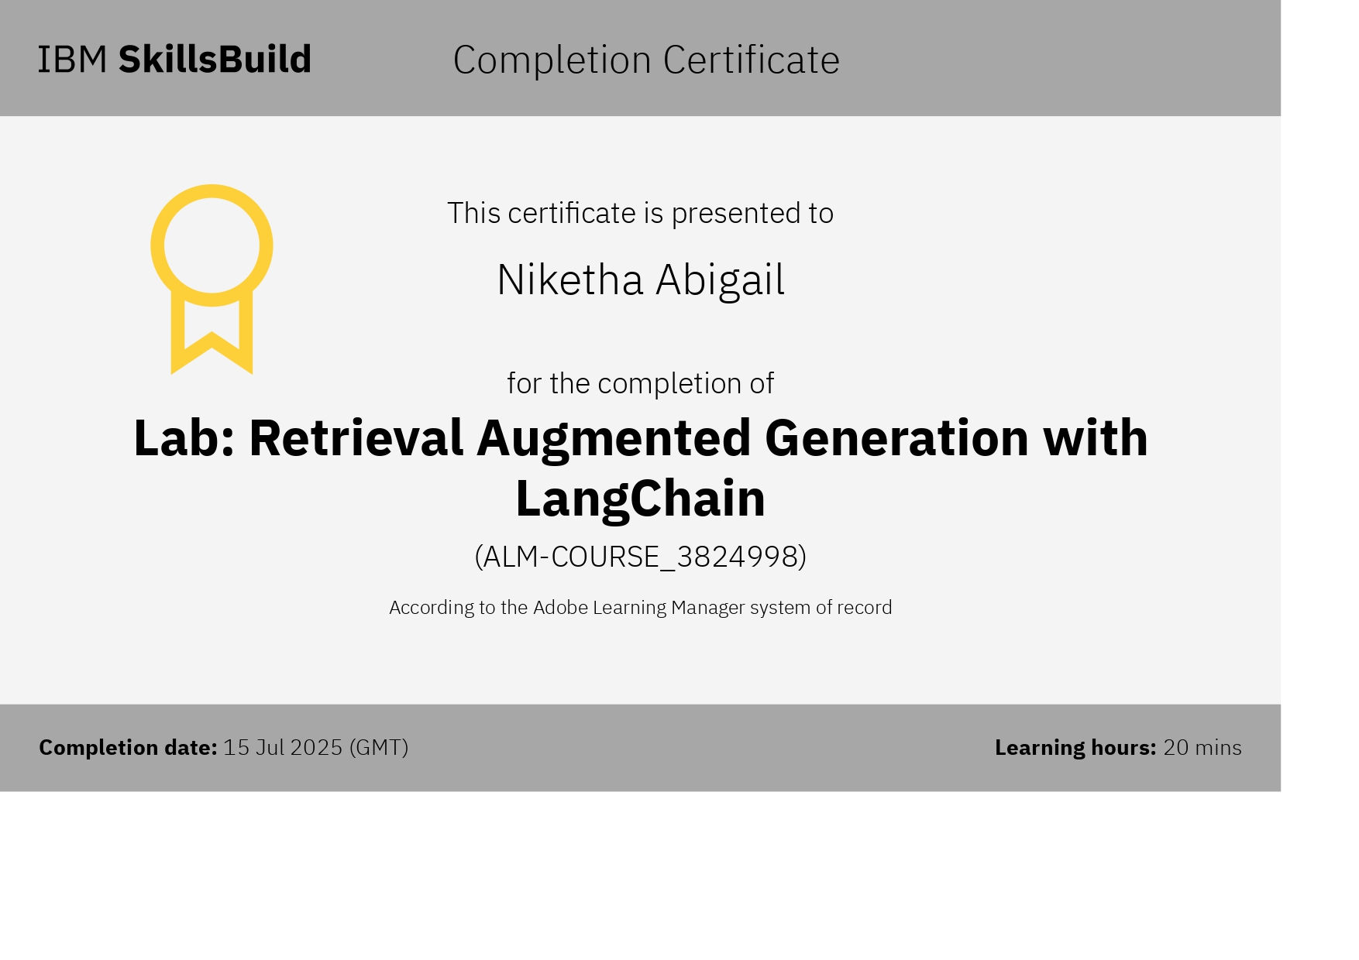
Attach your RAG LAB certificate here

Slide 16
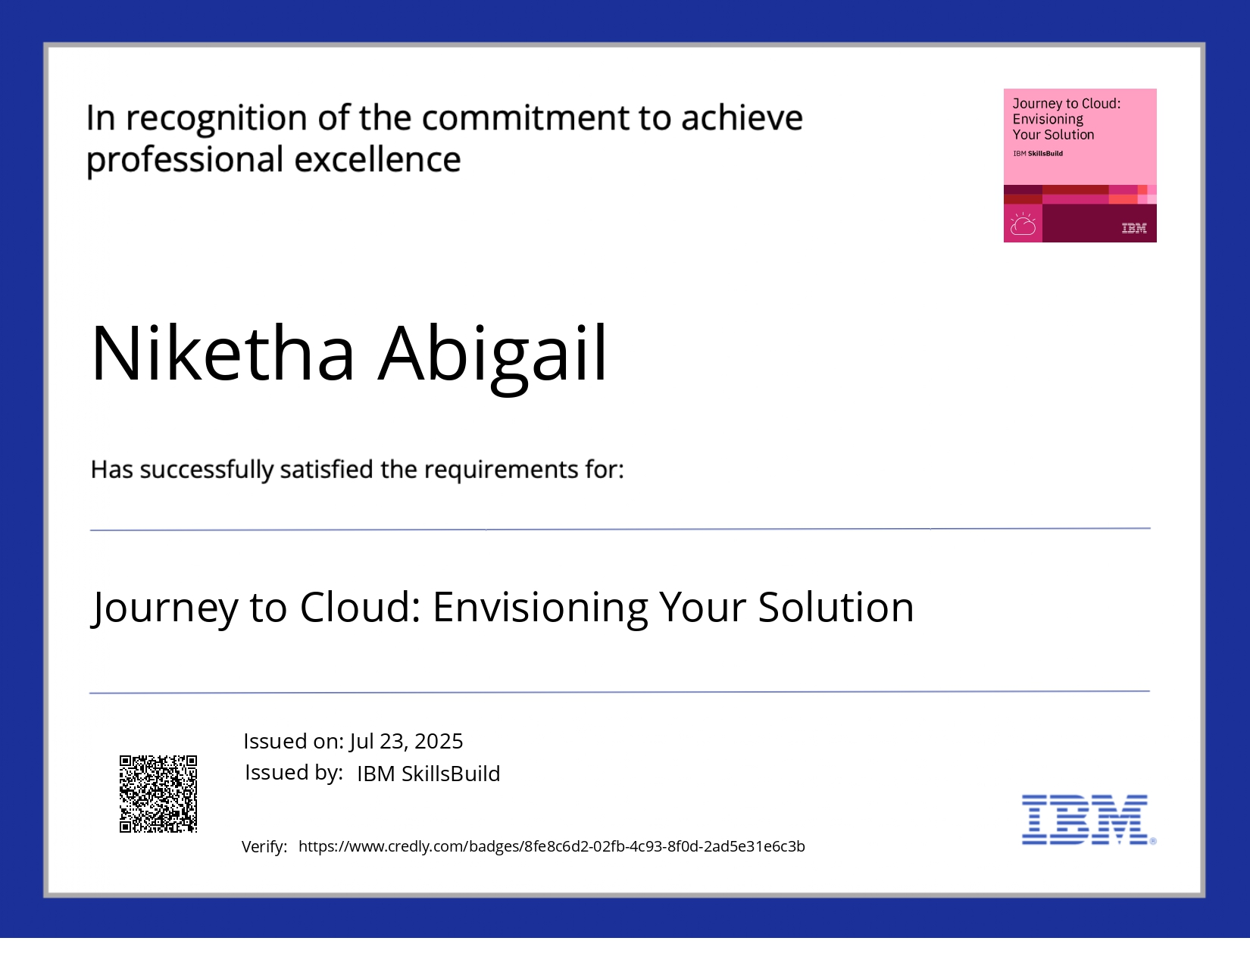
IBM Certifications

Slide 17
Git hub link : https://github.com/NikethaAbigail/Nutrition-Agent

Slide 18
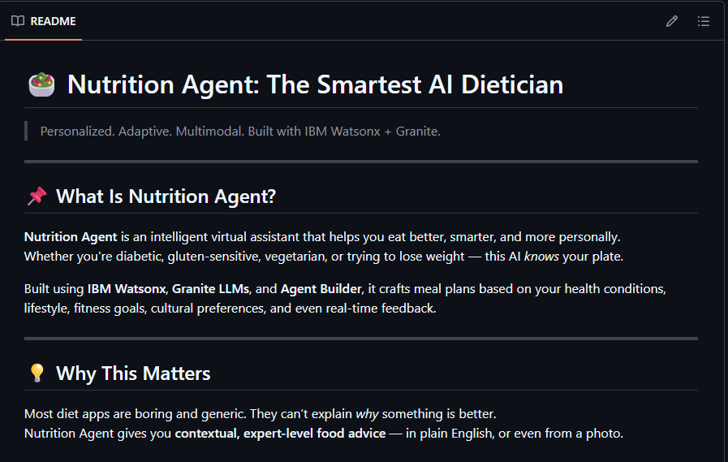
GitHub Link
https://github.com/NikethaAbigail/Nutrition-Agent

Slide 19
THANK YOU

